Slide 1
Chapter 3：Classic Chart
Alukardo

Slide 2
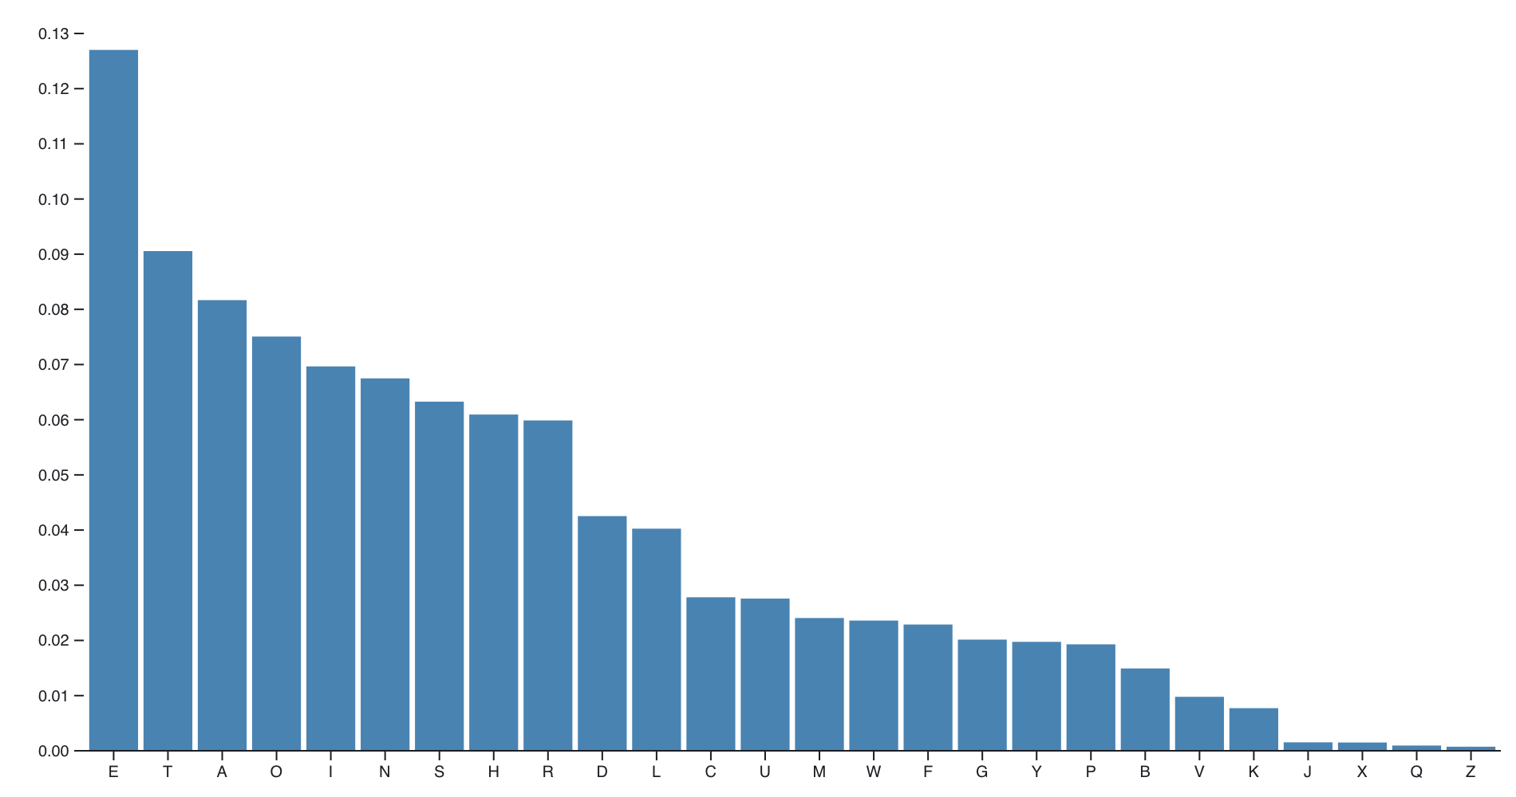
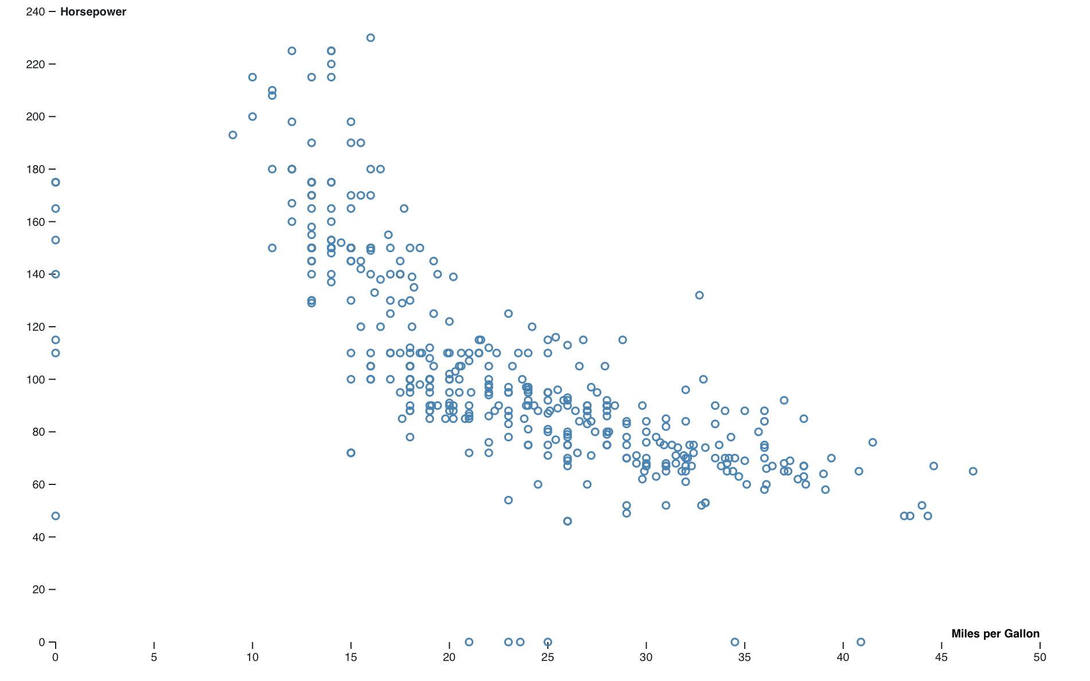
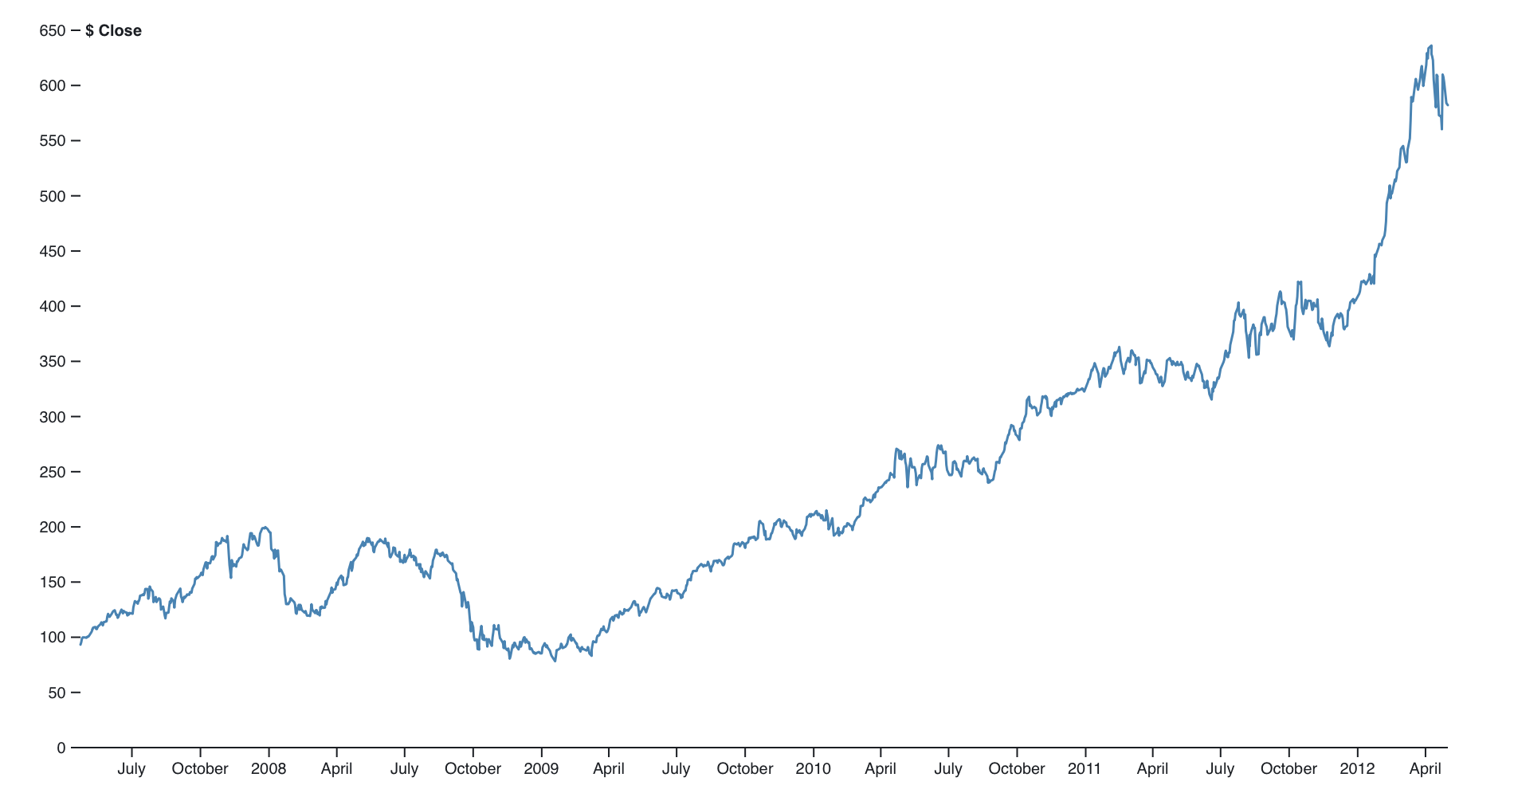
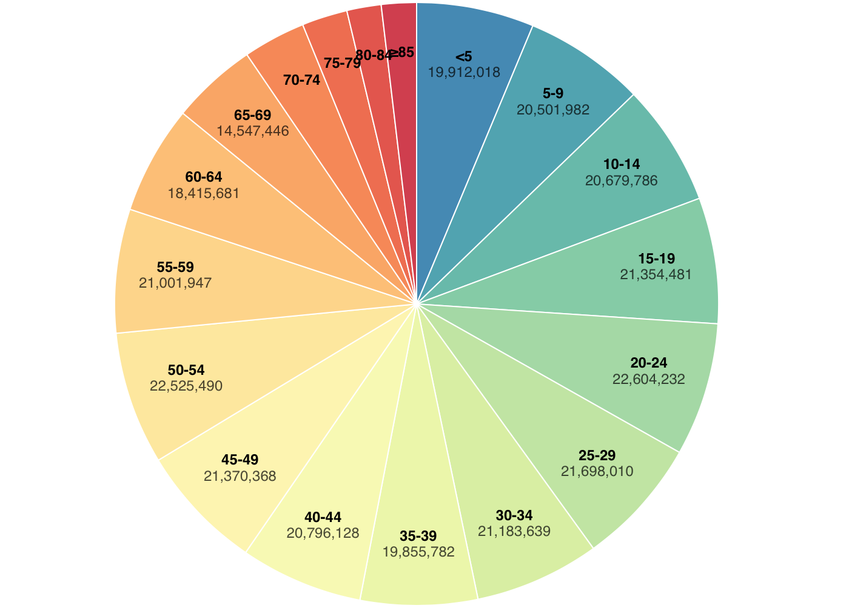
Introduction
Reference: Summary of 33 classic chart types

Slide 3
Chart elements
Axis
Content
Infomation Text
Interactions
Layout

Slide 4
Axis
d3.scaleLinear()
d3.axisBottom()
d3.axisLeft()

Slide 5
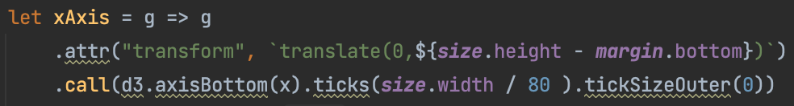
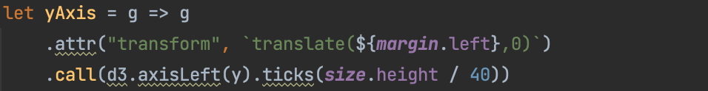

Axis

Slide 6
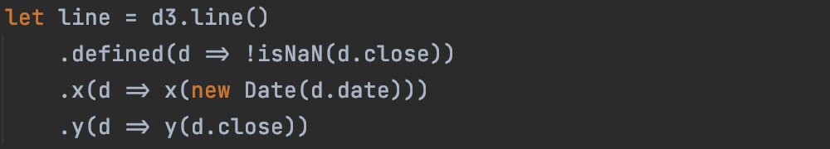

Context
d3.line()
d3.arc()

Slide 7
Infomation Text
Tittle
Descriptions
Some else

Slide 8
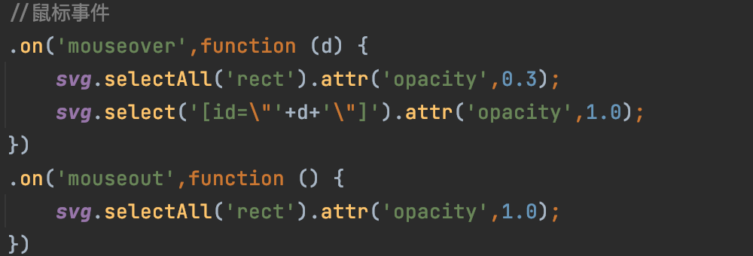
Interactions
Function .on( )

Slide 9
Layout
Transform

